Slide 1

TUTORIAL 5: HIGH PERFORMANCE DATA ANALYTICS 101
Hui Liang, Lead Data Scientist
Wei Ann Lim, Data Scientist
APJ Innovation Center, Hewlett Packard Enterprise, Singapore
March 13, 2017

Slide 2
Schedule
9:00 am – 10:30 am
10.30 am – 11.00 am
11.00 am – 1.00 pm
1.00 pm – 2.00 pm
Track 1 Machine Learning
Morning Tea Break
Track 2 Text Analytics, Track 3 HPC & Data Analytics
Lunch Break

Slide 3
Track 1: Machine Learning
Wei Ann Lim, Data Scientist
APJ Innovation Center, Hewlett Packard Enterprise, Singapore
March 13, 2017

Slide 4
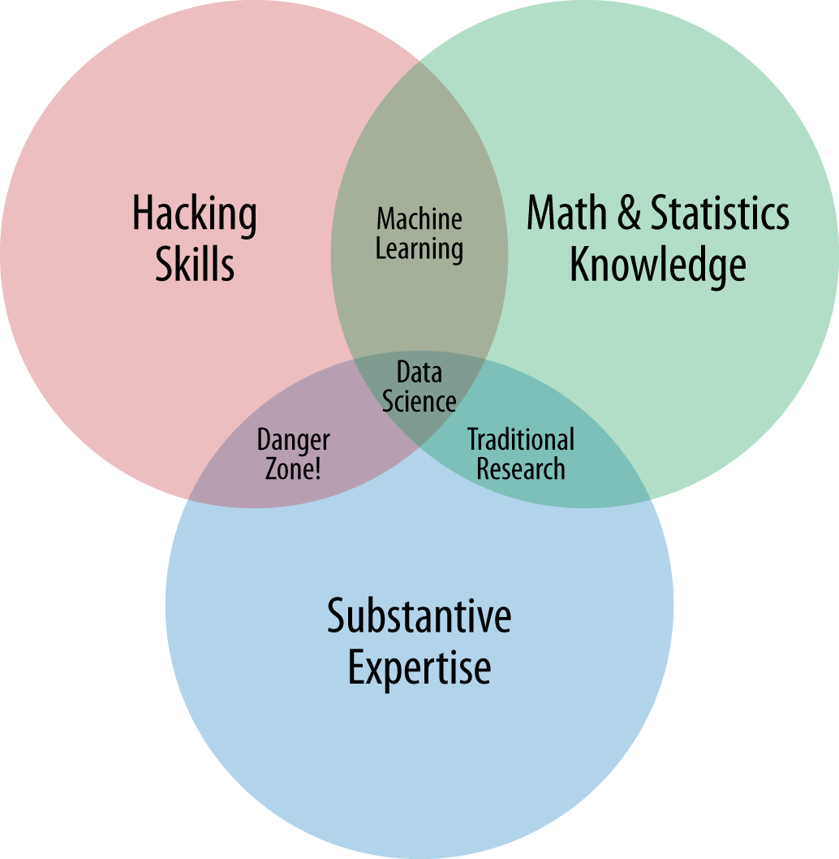
Introduction
Data Science, Machine Learning , Business Analytics, Deep Learning.
Business Analyst? Business Intelligence?
Artificial Intelligence!
Venn Diagram by Drew Conway
Definition of Data Science
Notes:
What is data science? There is no real standard definition.
So there are many terms there are used to describe this field. For example data science ….
These term can be confusing and misleading. So they are sometimes used wrongly.
for example a JD may be asking for a data scientist, but the description, talking about dashboard and reporting, is actually more appropriate for the term business intelligence.
And a JD for business analyst is actually for someone managing certain process of the business and not for someone doing business analytics.
The informal definition of a data scientist is someone who is better than a programmer in statistics and better than a statistician in programming. So a data scientist is really someone falling in between.
Another definition is provided by Drew Conway, an American data scientist. He defines a data scientist who has some hacking skills, math and statistics and business knowledge.
Recently, there is another buzz word, Artificial Intelligence. This term arose due to the recent advances in deep learning.
In my opinion, a data scientist is someone who has intuition about data, and is involved in writing a program to analyze data, and automatically generate conclusions to drive an action.

Slide 5

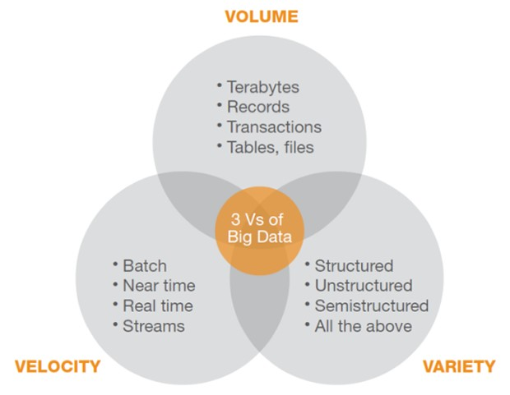
Notes:
Big data
I hate these 2 words. Once a manager in my previous job asked me to analyze "big data" stored on excel sheet.
What is big data then? It is data that cannot fit in a single machine.So if our laptops have 1 TB of memory, with HPC type performance, will there still be the term big data?
Who has heard of the 3Vs of big data – Volume, Variety,Velocity

Slide 6
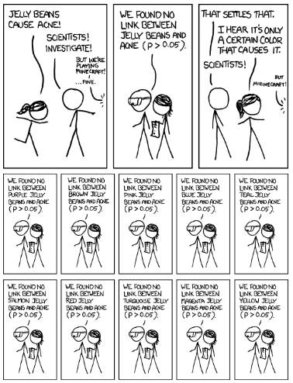
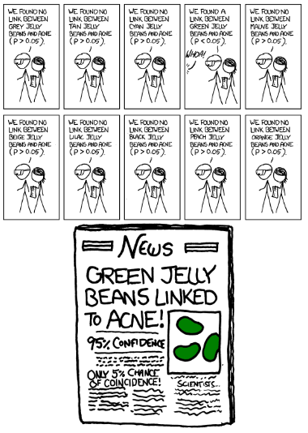
Notes:
Be careful of spurious relationship.

Slide 7
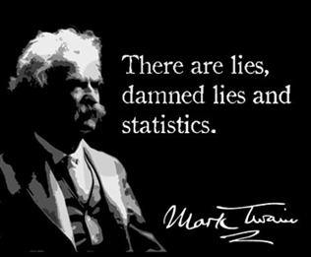
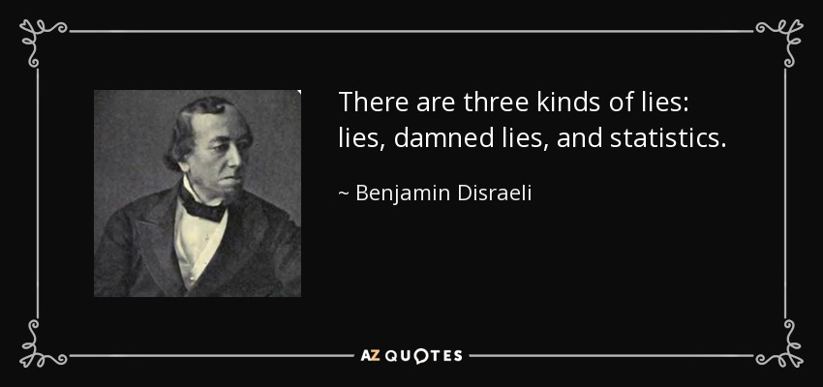
Notes:
Fake quotes.
The term was popularized in the United States by Mark Twain (among others), who attributed it to the 19th-century British Prime Minister Benjamin Disraeli
Trust Wikipedia.

Slide 8
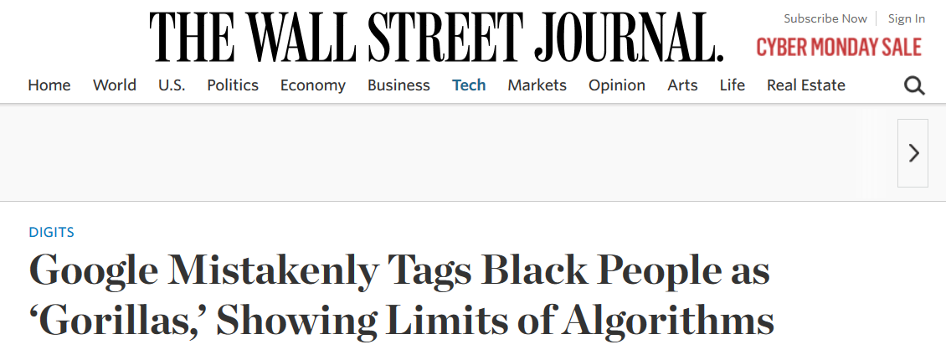
Be Careful

Slide 9

















Data Analysis Pipeline
Get Data
EDA
Data Stores
Exploratory Data Analysis
Types of data (continuous, categorical, hierarchical)
Data Pre-processing
Building Models
RDBMS
HDFS
NoSQL
Quirks
Biases and distribution of data
Prepare to Build the Model
Training, validation, and test data. (e.g. 60%, 20% 20%).
Is the data a sequential data?
Data cleanup – remove NAs, fill blanks, normalize data etc.
To do
Do not choose variables you cannot get at production time as features.
Choose evaluation criteria and train hyper-parameters.
Choose the best model.
Build Data Product
Considerations
Monitor performance of model.
Decide model update frequency.
Technical support
Notes:
Quirks of data e.g. What could be wrong with the data, missing data, misspelt data, errors in the data.
Distribution of data.
Are there categories where there are only very few data points?

Slide 10
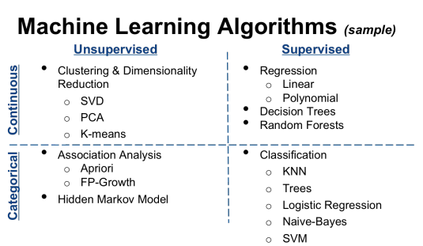
Notes:
Picture courtesy of https://medium.com/@RobinCRLee/supervised-vs-unsupervised-learning-36d5106c7b0b#.fn1df7j6v
I’ll talk about linear Regression, and if time permits, logistic regression.

Slide 11
Regression

Slide 12
Assumption About You
You have basic understanding of middle school mathematics
Square root.
Scatter Plot.
Mathematical symbols like differentiation, integration, and summation.
Statistics e.g. mean, median, mode, variance, standard derivation
Notes:
And my goal here is to make you fall asleep.
If you don’t, I am not doing a good job explaining how regression works to you.

Slide 13
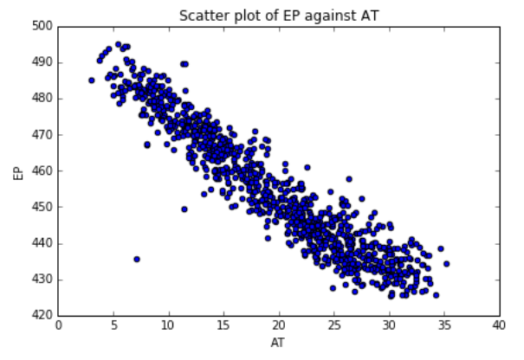
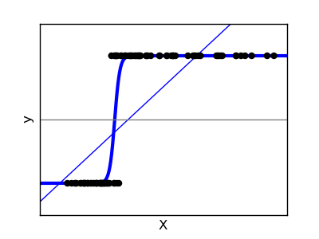
Types of Regression
Types of Regression
Predict Value
Linear Regression
Value expected
Classification
Logistic Regression
A or B?
Notes:
There are 2 broad classes of regression techniques:
1. predicting continuous values
And another for predicting categorical values aka different classes e.g. diseased or not diseased, spam email or not.

Slide 14
What is Linear Regression
“Grand-daddy” of all “Machine Learning” Algorithm
Identifying the linear relation between independent variables (X₁, X₂ … X_{n}) and dependent variables (Y).
Prediction about the dependent variable can be made by knowing the independent variables.
Control the value of the dependent variable.
Relationship between the ambient temperature and electrical power output of in a power station.
Notes:
The goal is, given a set of variable, find the relationship between the independent variables and the dependent variable.
And we are going to find this relationship using math
The basis of most machine learning algorithm is math.
In this case, X = ‘AT’, Y = ‘EP’

Slide 15
Finding Relationships
Relationship between the ambient temperature and electrical power output of in a power station.
Notes:
Is this line good enough?

Slide 16
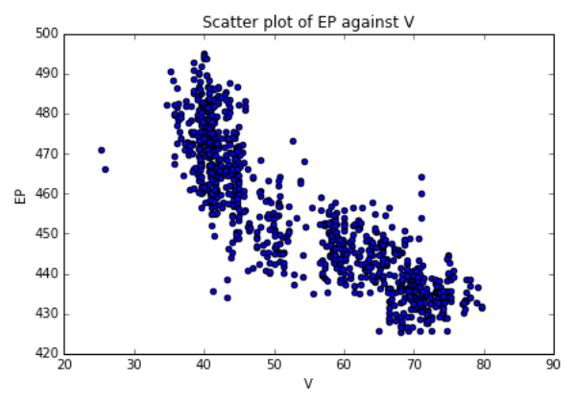
Finding Relationships
Notes:
Is this line good enough?

Slide 17



Finding Relationships
Symbols
i: the superscripts, indicates which data point
j: the subscripts, indicates which variable
h(x^{(i)}): The predicted value of data point number i
Start with a hypothesis:
You are familiar with Y = mX + c
m is the gradient
c is the Y-intercept aka the bias term
Generalize
θ₀x₀ becomes the Y-intercept
The set of θ_{j} is known as the parameters instead of the gradient.
Notes:
We call theta the parameters

Slide 18
Finding Relationships
2. Assume an initial value of parameter θ_{j.}
E.g. assume all θ_{j} equals 0 initially
Notes:
We start by assuming all the thetas equal to 0.
And we make predictions. In this case, we assume all the predictions are 0.

Slide 19

Finding Relationships
3. Measure the errors of the hypothesis
Recall,
Choose θ that results in the hypothesis being close to the actual value, Y.
Error of a point = h(x) - y
More accurately, error of a point = (h(x) - y)²
Error of all points, aka cost function,
IS THERE AN EFFECTIVE WAY OF CHOOSING θ?

Slide 20
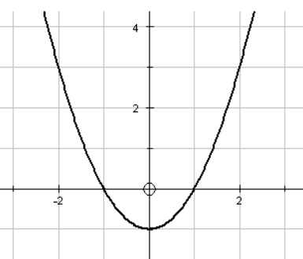
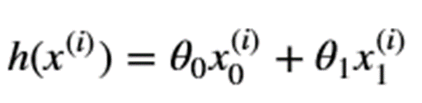
Side Track
Cost, J
Where
θ₁ (note, axis is not x)
Notes:
Side track to explaining differentiation to find the minimum point.

Slide 21



Finding Relationships
4. Find the best parameters that will reduce the errors
By partial differentiation of the cost function for each θ,
Followed by changing the parameters by a small amount, α
Multiply with the data associated with variable j only.
REPEAT

Slide 22


Slide 23



Algorithm Summary
Symbols
i: the superscripts, indicates which data point
j: the subscripts, indicates which variable
h(x^{(i)}): The predicted value of data point number i
Start with hypothesis:
Initialize θ_{j}
For each data point, calculate errors
For each θ_{j}, calculate its gradient
Update the value of
Repeat from step 3 until a certain number of iteration is reached or when error decreases by only a small amount.
Notes:
1. Matrix multiplication.
2.
3. 4. 5. Matrix operations

Slide 24
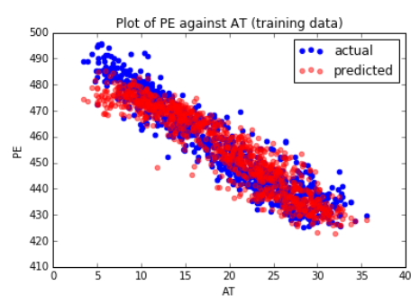
Predictive Performance

Slide 25
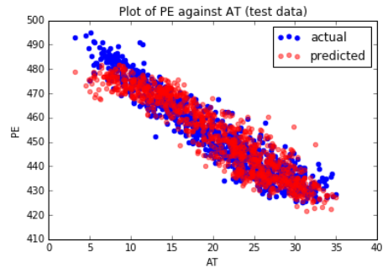
Predictive Performance

Slide 26
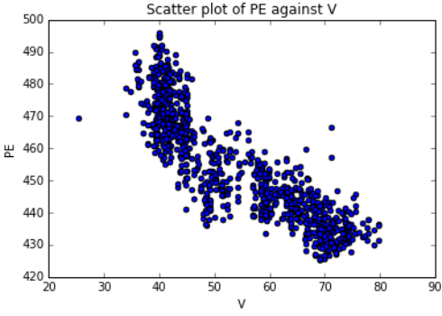
Improving the Model
Higher Order Variables: e.g V² or log(V) instead of V
Include more variables
Beware of overfitting!

Slide 27
Logistic Regression

Slide 28
What is Logistics Regression
Types of Regression
Predict Value
Linear Regression
Value expected
Classification
Logistic Regression
A or B?
Notes:
There are 2 broad classes of regression techniques:
1. predicting continuous values
And another for predicting categorical values aka different classes e.g. diseased or not diseased, spam email or not.

Slide 29






Logistic Regression vs.. Linear Regression
Linear Regression
Logistic Regression
Find the best hyperplane that is best able to go through all the data.
Output is a continuous values.
Cost function
Find the best hyperplane that is able to separate the data into 2 groups.
Output is a binary value
Cost function

Slide 30
Clustering

Slide 31
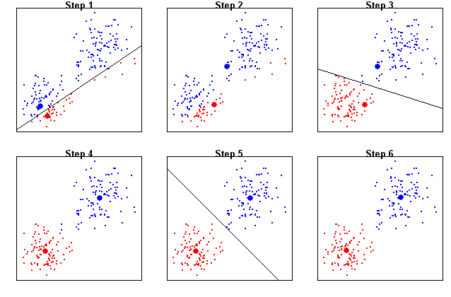
What is Clustering?

Slide 32
Clustering Algorithms
Hierarchical Clustering
Kmeans Clustering
Bottom Up
Number of clusters required is unknown at the start.
Group 2 nearest points into a cluster.
Has a clear end to the algorithm.
Top Down.
Number of clusters required is “known”.
Assign a number of data points as the cluster centers and assign the other data points to the cluster center nearest to it.
Not always clear when algorithm is good enough.
See More in the Demonstration.

Slide 33
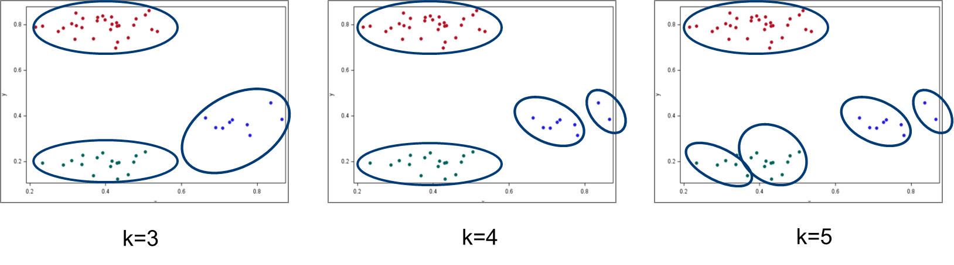
Clustering Is Easy, Isn’t It?

Slide 34
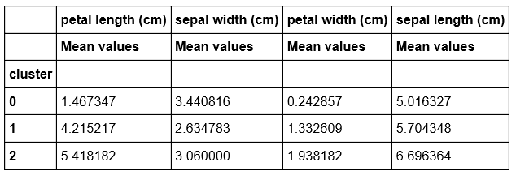
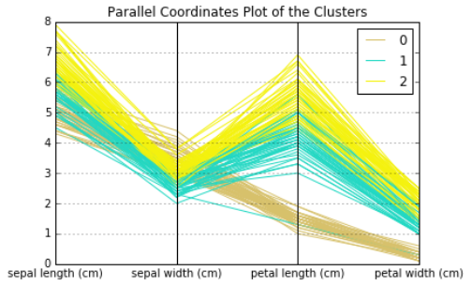
Characteristics of Clusters

Slide 35
Lesson Summary
Notes:
We have see the many common terms to describe what is being done in this field.
Data Science, business analytics, machine learning, deep learning, AI. I have attempted to give my own interpretation.
But really, there is no single definition, only subtle differences.
Then we went on to see what’s going on in linear regression, logistic regression and clustering. This is just tip of the ice berg.
You’ll realize that machine learning means making decisions using mathematics.
In this short time, we were unable to discuss the problem of overfitting, the curse of dimensionality, and the different problems that we can see in data, and how to deal with them.
But my advice is, visualize the data, understand the spread of the data, decide whether normalization is required before apply a machine learning algorithm.

Slide 36
Take Away
Models in data science are based on Mathematics.
Know your data before building models.
About formulating the cost function, and adjust the parameters by iterations.
Visualizing how values, parameters etc. change can help in finding the best parameters.
The best model is dependent on the nature of the data.
Estimate performance of the model on test data.
Normalize the variables before building model.

Slide 37
Advance Topics
Spurious Correlation, Quirks in modelling, Inferring Data
Class Imbalance
Regularization
L1 regularization, aka, Lasso
L2 regularization, aka, Ridge Regression
Batch learning, online learning
And many, many more... ...
Notes:
In statistics, a spurious relationship (see also spurious correlation and spurious regression) is a mathematical relationship in which two or more events or variables are not causally related to each other (i.e. they are independent), yet it may be wrongly inferred that they are, due to either coincidence or the presence of a certain third, unseen factor
Quirks in modelling – e.g. change of the sign of the coefficient

Slide 38
Thank You for Your Attention

